Slide 1

Lecture 3: UDP Sockets
Network Programming
(IT431)
Dr. Hosny Ahmed Abbas
 01007478550
→ hosny.abbas@fci.luxor.edu.eg
Information Technology Luxor Faculty of Computers and Information

Slide 2
Topics to be covered
UDP Sockets
UDP Sockets Practical Applications

Slide 3
UDP Sockets
UDP stands for User Datagram Protocol.
no guarantee of arrival.
no guarantee of the order of delivery.
The lack of overhead can make it significantly faster than TCP.
Reliability against Speed.
The video is a good example of an application that uses UDP.
Connectionless: We don't establish a point to point connection between a client and a server.

Slide 4
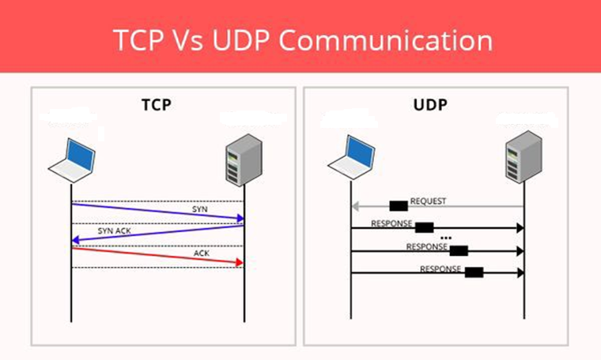
UDP Sockets

Slide 5
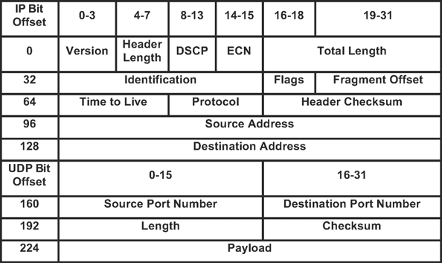
UDP Sockets
IP and UDP packet headers

Slide 6
UDP Sockets
DatagramSocket
DatagramPacket
Sender
Converting your message M to an array of bytes M_{b}
Create a DatagramSocket (S)
Create DatagramPacket (P)
Fill P with M_{b}
Send P
Receiver
Create a DatagramSocket (S)
Create DatagramPacket (P)
Receive with P
Extract M_{b} from P

Slide 7
UDP Sockets
Receiver
Create a DatagramSocket (S)
DatagramSocket S=new DatagramSocket(4000);
Create DatagramPacket (P)
byte[] buffer=byte[20];
DatagramPacket P=new DatagramPacket(buffer,buffer.length);
Receive with P
S.receive(P);
Extract M from P
String M=new String(P.getData());
Closing the socket
S.close();

Slide 8
UDP Sockets
Sender
Define your message (M)
String M= “Welcome to Luxor University";
Create a DatagramSocket (S)
DatagramSocket S=new DatagramSocket();
Create DatagramPacket (P) and Fill P with M bytes.
DatagramPacket P=new DatagramPacket(M.getBytes(),M.length(),
“localhost”,4000);
Send P
S.send(P);
Closing the socket
S.close();

Slide 9
UDP Sockets
UDP Applications
The Domain Name System (DNS)
The Simple Network Management Protocol (SNMP)
The Routing Information Protocol (RIP)
The Dynamic Host Configuration Protocol (DHCP)
Transmission Speed is more important than Reliability

Slide 10
UDP Sockets Practical Applications
Implement a UDP Server that Run in Infinite Loop handling Multiple Client Requests, one at a time. The server receives a number N from the client then it calculates its factorial (N!) and sends back the result to the client. Test your server with multiple clients’ connection requests. A client should get the number N from the user, don’t hard code the number inside the client.

Slide 11
UDP Sockets Practical Applications
Develop a network application with the client-server architecture in which the server solves a quadratic equation of the form (ax2+bX+c =0). The clients send the coefficients a, b, and c to the server in one message and receive the result from the server in one message. The client should prints the result on the console. Also the client should get the coefficients from the user. The server must run in an infinite loop waiting for clients’ requests.

Slide 12
References
Internet

Slide 13
Thank You

